Slide 1
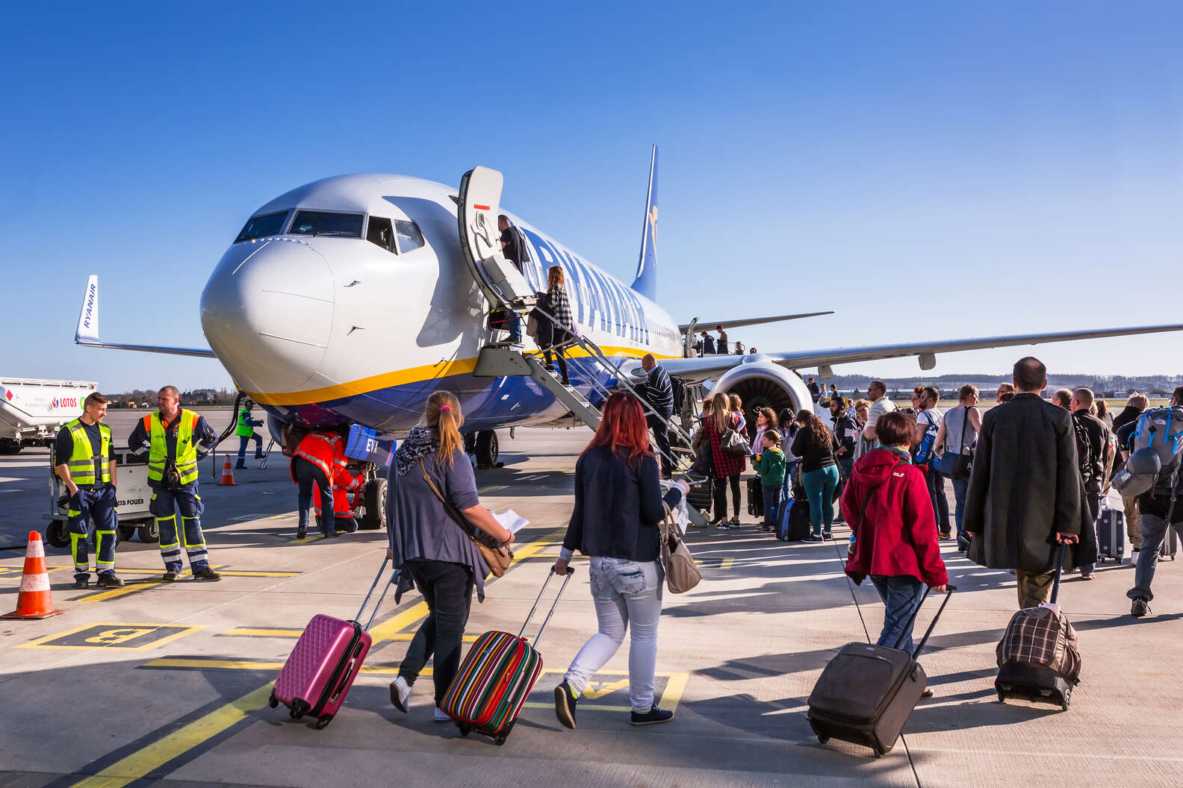
FLIGHT JOURNEY price Prediction Project
By
KOUSHIK BISWAS

Slide 2
TABLE OF CONTENTS
Abstruct
Introduction
Problem Statement
Conceptual Background of the Domain Problem
Data Sources and their formats
About The DataSet
Data Preprocessing
Hardware and Software Requirements and Tools Used
selected models
Accuracy score of the model
Parameter tuning
Final model
Visualizations
Interpretation of the Results
Conclussion

Slide 3
Abstruct
. A Flight journey price prediction has been a high-interest research area, as it requires noticeable effort and knowledge of the field expert. Considerable number of distinct attributes are examined for the reliable and accurate predictions. To build a model for predicting the price of flight journey, we applied many machine learning techniques (Linear Regression, Support Vector Machine ,DTC,Random Forest,etc). The data used for the prediction was collected from the web portal www.yatra.in using web scraper that was written in python programming language. Respective performances of different algorithms were then compared to find one that best suits the available data set. Furthermore, the model was evaluated using test data and the accuracy of 87.38% was obtained.

Slide 4
Introduction
This project aims to predict ticket prices for upcoming flights to help customers in selecting the optimum time for travel and the cheapest flight to the desired destination.
In this paper, a machine learning model is proposed to predict a flight journey price based on data related to the flight journey (airline,departure time,time of arrival,duration,number of stops,etc.). This will facilitate the reproducibility of our work. In this study, Python programming language with a number of Python packages will be used.

Slide 5
Problem Statement
Anyone who has booked a flight ticket knows how unexpectedly the prices vary. The cheapest available ticket on a given flight gets more and less expensive over time. This usually happens as an attempt to maximize revenue based on –
1. Time of purchase patterns (making sure last-minute purchases are expensive)
2. Keeping the flight as full as they want it (raising prices on a flight which is filling up in order to reduce sales and hold back inventory for those expensive last-minute expensive purchases)
So, they are looking for new machine learning models from new data. We have to make flight price valuation model. This project contains two phase-
• Data Collection Phase
• Model Building Phase

Slide 6
Conceptual Background of the Domain Problem
we are going to work on a dataset which consists information about the flight journey price. When we work on these sorts of data, we need to see which column is important for us and which is not. Our main aim today is to make a model which can give us a good prediction on the price of flight journey based on other variables. We are going to use Linear Regression for this dataset and see if it gives us a good accuracy or not.

Slide 7
Data Sources and their formats
I have scraped the flights data from yatra.com . The dataset contains 3555 rows and 9 columns having both numerical and categorical data.
In this dataset " Price" is our target variable which has float values. So this is a "Regression type" problem.
you can download the dataset from the below link.
Dataset link:
https://github.com/KBkoushik/Flight-Price-Prediction-Project/blob/5e7dfa256e1b30e53e0c57432ab29791b12ae95b/Flight_Prices(web%20scraping).xlsx

Slide 8
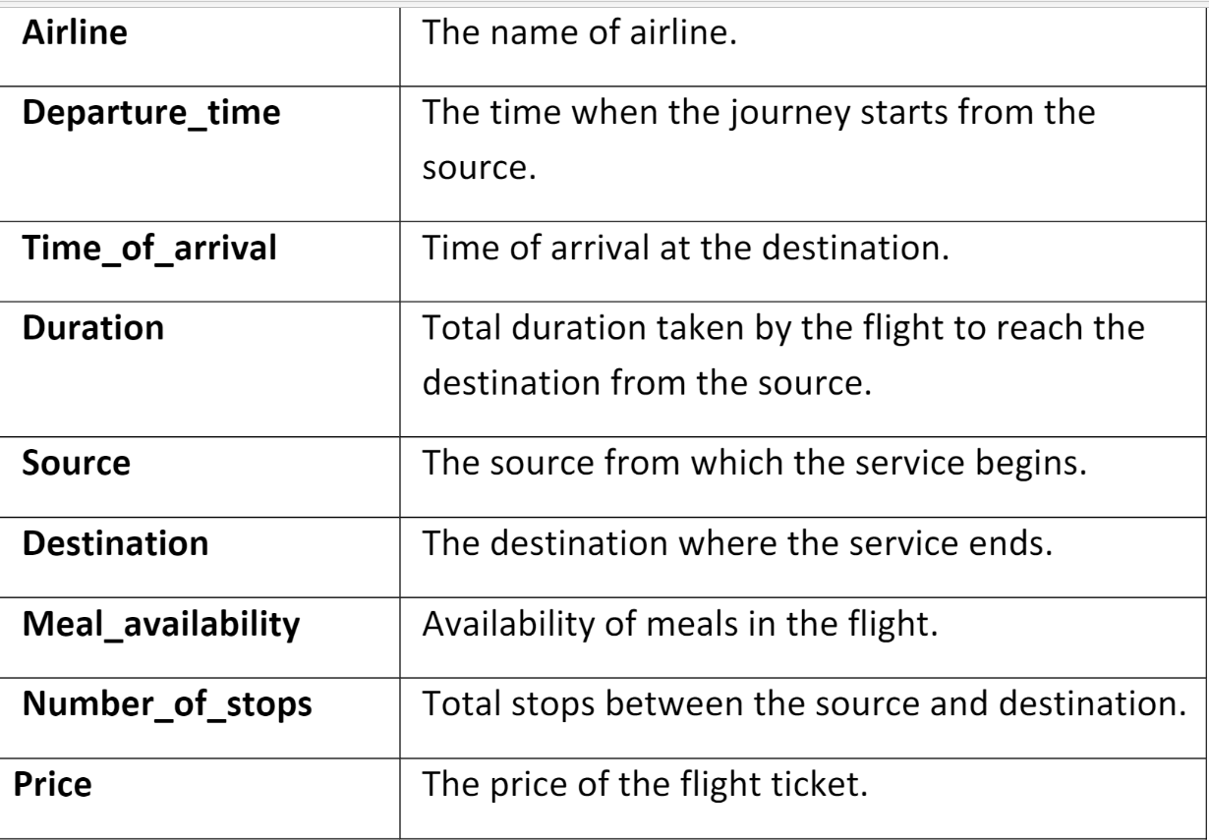
About The DataSet

Slide 9
Data Preprocessing
For the purpose of the project the dataset has been preprocessed as follows:
• we divide all the columns into categorical and numerical types
• Univariate Analysis Of Categorical Columns and numerical columns.
• Checking correlation with target column using Heatmap
• Checking skewness of each columns
• Handling missing value
• Checking Outliers and removing outliers by zscore
• Encoding the categorical column by Label Encoder
• Dividing data into features and vectors
• Checking VIF score
• Removing skewness by power transform method
• Standardizing the data by standard scaler

Slide 10
Hardware and Software Requirements and Tools Used
Hardware:- Desktop/Laptop
Software:- Anaconda

Slide 11
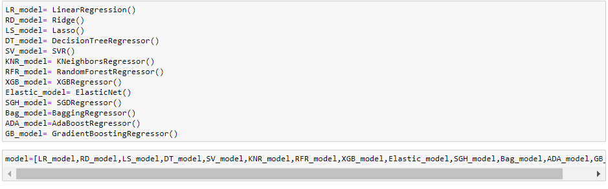
selected models
I used 13 different regression algorithms to get the ideal one for prediction.

Slide 12
Accuracy score of the model
Model Name | Accuracy Score
LinearRegression | 0.6452931539854956
Ridge | 0.6452931277823244
Lasso | 0.6452931539375557
DecisionTreeRegressor | 0.9999916527197423
SVR | 0.06459263507374624
KNeighborsRegressor | 0.8702798291992135
RandomForestRegressor | 0.9852526380106977
XGBRegressor | 0.9942845188810525
ElasticNet | 0.598853842807132
SGDRegressor | 0.6439521543615279
BaggingRegressor | 0.9765825460543547
AdaBoostRegressor | 0.656591588244267
GradientBoostingRegressor | 0.908073849551413

Slide 13
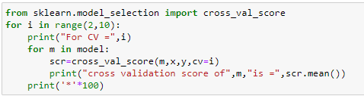
Cross Val Score
After Runing this code we get best cross val score from GradientBoostingRegressor & RandomforestRegressor for CV=8

Slide 14
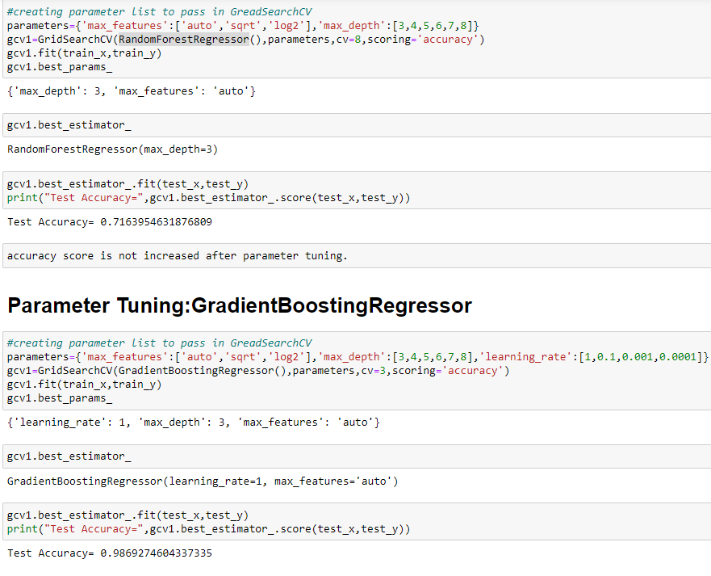
Parameter tuning
accuracy score has decreased after parameter tuning RandomforestRegressor and increased for GradientBoosting Regressor.Now we will create final model with this GradientBoosting Regressor parameter.

Slide 15
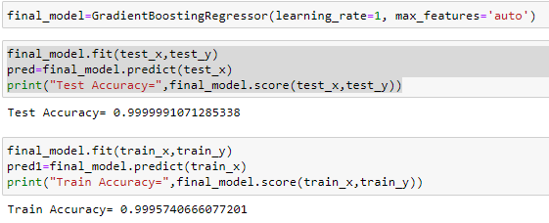
Final model
since difference between train accuracy and test accuracy is very less ,our final model is not overfit or underfit.

Slide 16
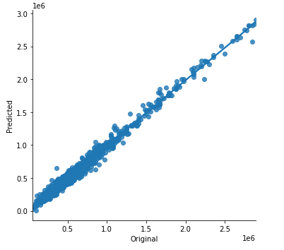
Visualizations
We can see that the original flight journey price and final model’s predicted price are almost same which means model performance is good.

Slide 17
Interpretation of the Results
This particular problem needs a good vision on data, and in this problem Feature Engineering is the most crucial thing.
You can see how we have handled numerical and categorical data and how we build different machine learning models on the same dataset.
It is always advised to all of us that atleast we need to use 5 Algorithm in order to figure out which one is performing best among them and we choose that one and we send that for hyper parameter tuning to know that best parameter .
Using hyper parameter tunning we can improve our model accuracy, for instance in this model the accuracy increased.

Slide 18
Future Work
For future improvements, following step we thought to took-
Replacing model with a latest/different model
Using other robust datasets
Predicting result on differents attributes

Slide 19
Conclussion
When predicting flight journey prices, many complications were involved. There are many variables / attributes to consider in determining the price of a car and if all or most of them are used, we need a lot of calculating power to get the price of a flight journey. And it is very difficult to accurately predict flight journey prices in real life.
For any of machine learning project my suggestion is first you have to understand the problem on ground level .if you don’t allow yourself to work with diligence .if you don’ t work harder anything that you are doing or will do , not only in case of machine learning but also in life cycle would be futile. Maybe, my endeavour assist you when ever you will get stuck

Slide 20
THANK YOU

